Slide 1

AWS for Java Developers
#CampusParty2023

Slide 2

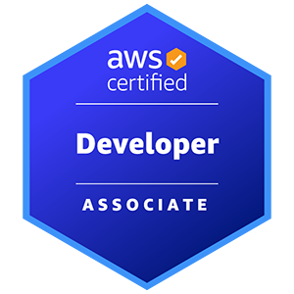
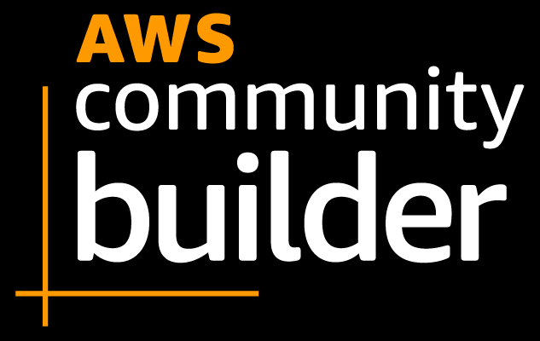




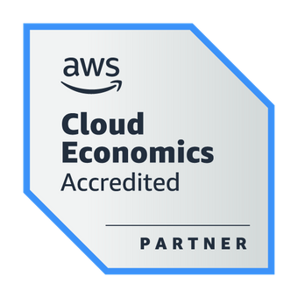
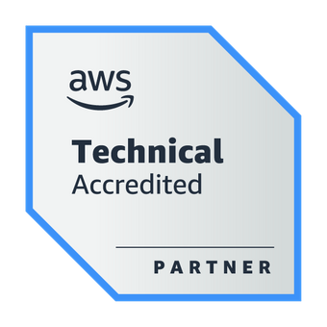
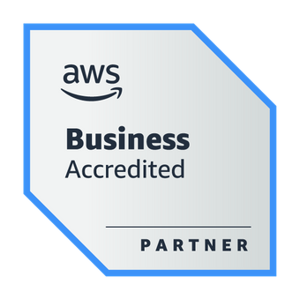

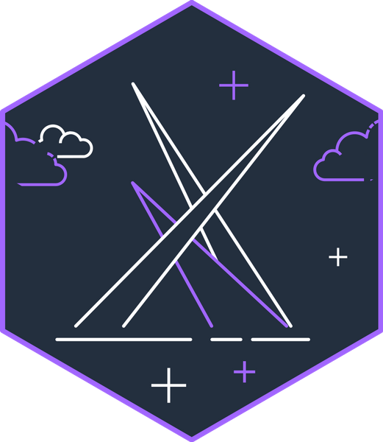
About the speaker
Weder Mariano de Sousa
Specialist Senior - GFT
Graduated Computer Science
https://www.linkedin.com/in/wedermarianodesousa/
Post Graduate in Midias UFG
https://github.com/weder96
Post Graduate in Information Security
https://twitter.com/weder96
https://dev.to/weder96
GOJava
AWS User Group Goiânia

Slide 3
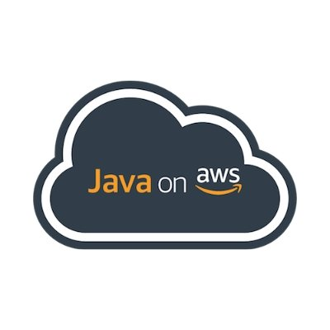
Agenda
SDK for Java
AWS IDE Toolkits
AWS CDK for Java
Amazon Corretto
EC2 with Springboot
Beanstalk and Springboot
Docker and Fargate with Springboot
Pipelines with Java Springboot
Serverless - Java and Lambdas with Springboot
AWS Lambda SnapStart for Spring Developers

Slide 4
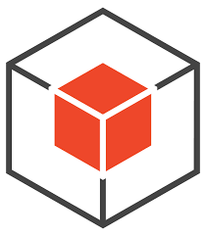
1. SDK for Java

Slide 5
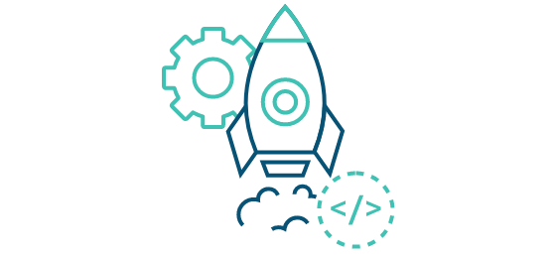
What is SDK for Java ?
The AWS SDK for Java simpliﬁes use of AWS Services by providing a set of libraries that are consistent and familiar for Java developers.
It provides support for API lifecycle consideration such as credential management, retries, data marshaling, and serialization. The AWS SDK for Java also supports higher level abstractions for simplified development.
GitHub to see examples (https://github.com/awsdocs/aws-doc-sdk-examples/tree/main) AWS-focused open source Java libraries.
- Aws Page Main Language Java
https://aws.amazon.com/developer/language/java/?nc1=h_ls

Slide 6

2. AWS IDE Toolkits

Slide 7
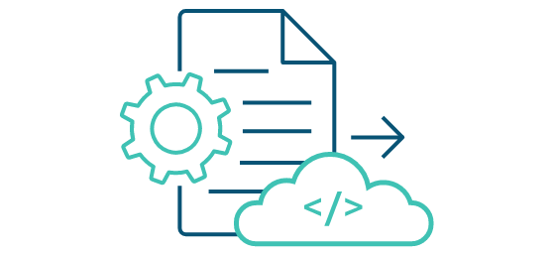
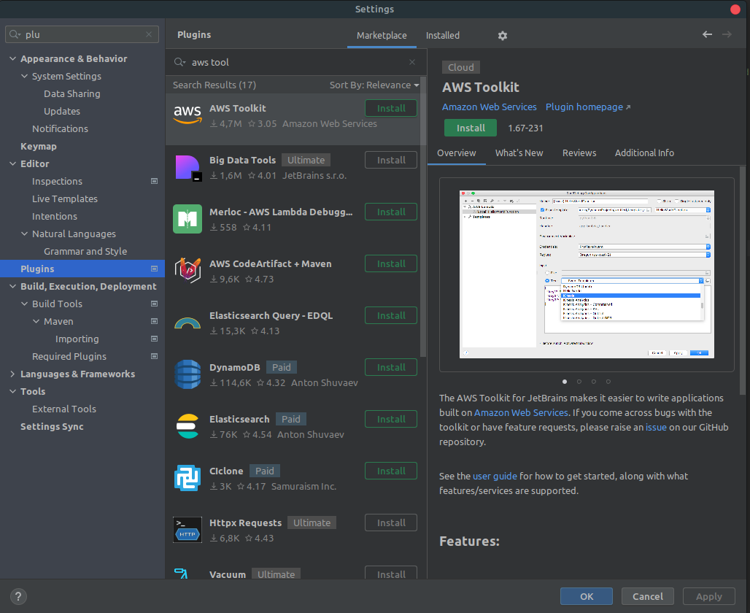
What is Toolkits de IDE da AWS ?
https://aws.amazon.com/intellij/

Slide 8
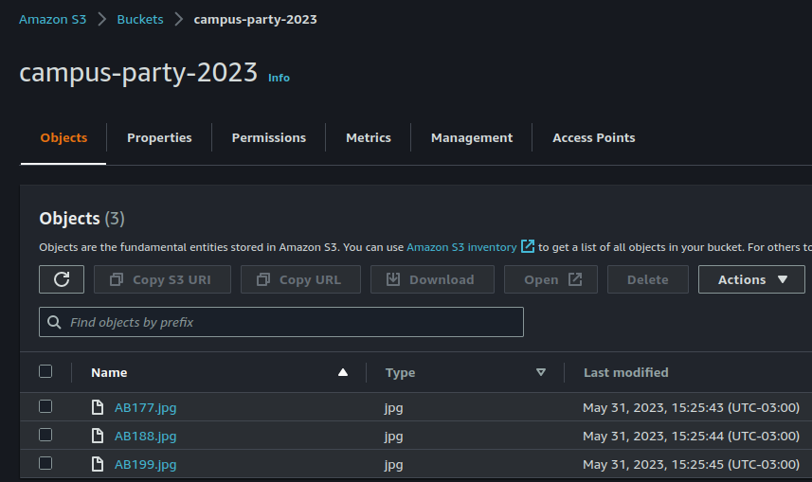
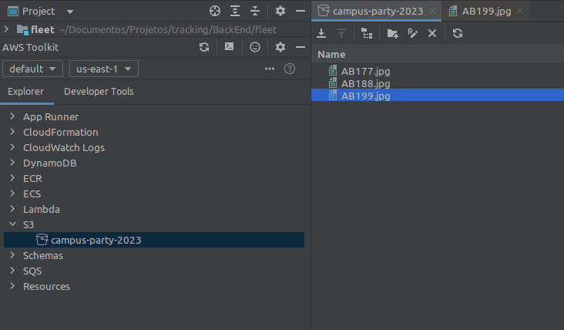
What is Toolkits de IDE da AWS ?
https://aws.amazon.com/intellij/

Slide 9
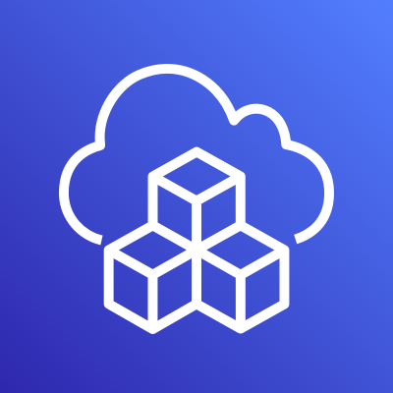
3. AWS CDK for Java

Slide 10
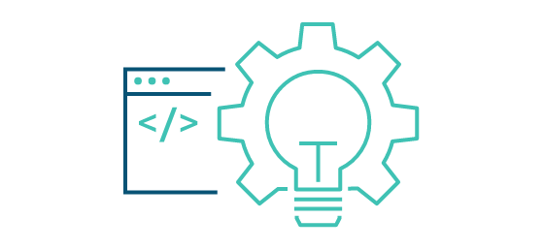
What is AWS CDK?
The AWS Cloud Development Kit (AWS CDK) is an open-source software development framework for defining cloud infrastructure as code with modern programming languages and deploying it through AWS CloudFormation.
https://aws.amazon.com/cdk/faqs/
https://aws.amazon.com/cdk/?nc1=h_ls

Slide 11
Difference between v2 and v1
CDK v1
CDK v2
"dependencies": {
"@aws-cdk/aws-amplify": "^1.125.0",
"@aws-cdk/aws-appsync": "^1.125.0",
"@aws-cdk/aws-codepipeline": "^1.125.0",
"@aws-cdk/aws-cognito": "^1.125.0",
"@aws-cdk/aws-lambda": "^1.125.0",
"@aws-cdk/aws-sns": "^1.125.0",
"@aws-cdk/core": "1.125.0",
"@aws-cdk/pipelines": "^1.125.0",
}
"dependencies": {
"aws-cdk-lib": "2.0.0",
"constructs": "^10.0.0",
"@aws-cdk/aws-iot-alpha": "^2.0.0-alpha.0"
}
import { App, Stack } from "@aws-cdk/core";
const lambda = require("@aws-cdk/aws-lambda");
import { App, Stack } from "aws-cdk-lib";
const s3 = require("aws-cdk-lib/aws-s3");
Notes:
In this example you can see how the packaging between v1 and 2 differs.
This example is using typescript and you can see that in the package json the amount of dependencies we need to import is very long.
When ever we update the version of CDK we need to update all the versions of all the dependencies. This is quite tedious work.
In the case of v2 there is only one package for all the libraries and then if we want to use some experimental construct we can just import that library with the specific version we are interested in.

Slide 12
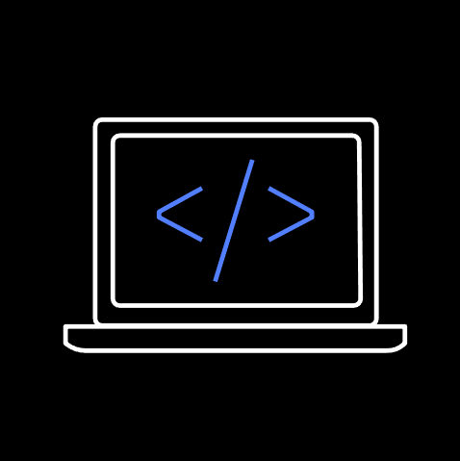
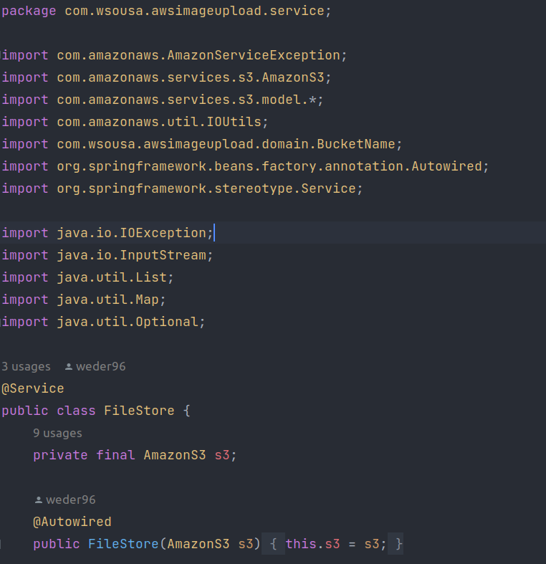





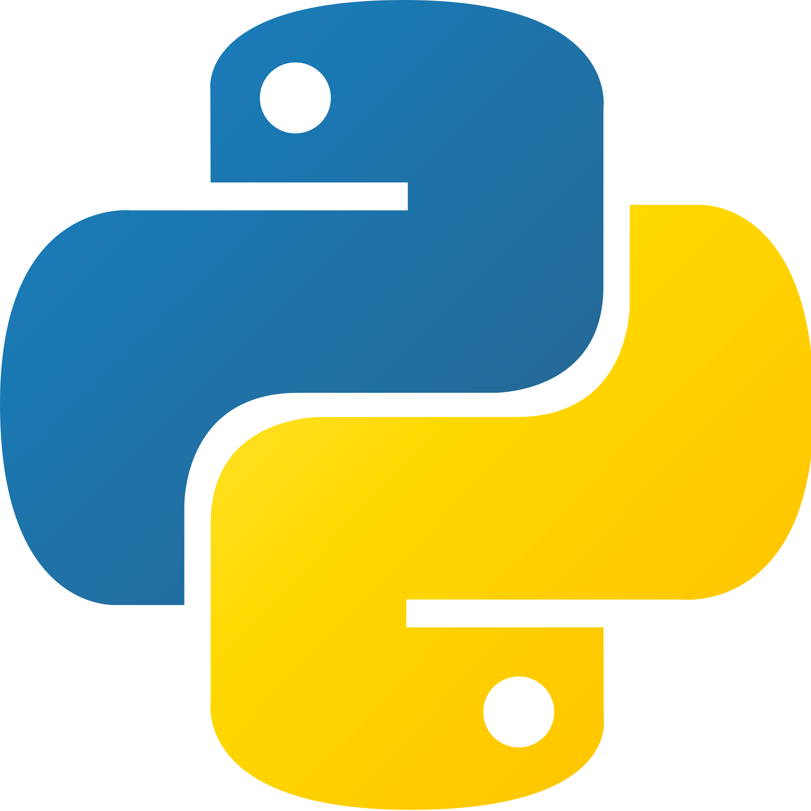
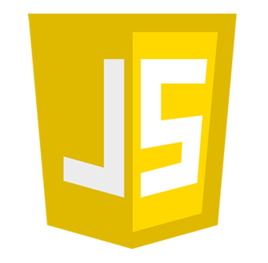

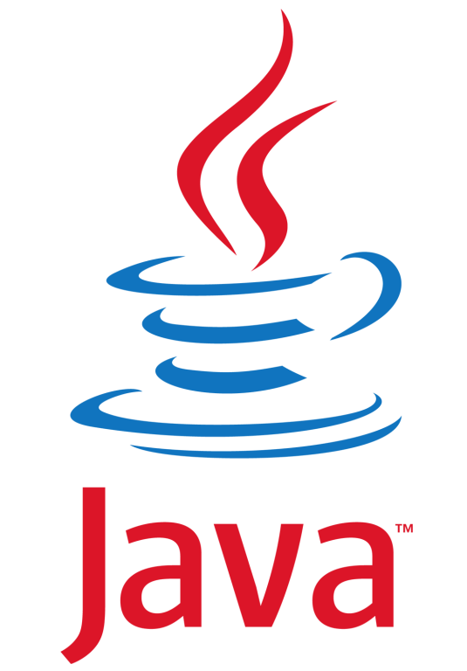
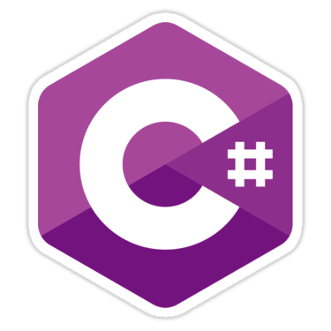


AWS Cloud Development Kit (CDK)
A multi-language software development framework for modeling cloud infrastructure
as reusable components
COMING
SOON!

Slide 13
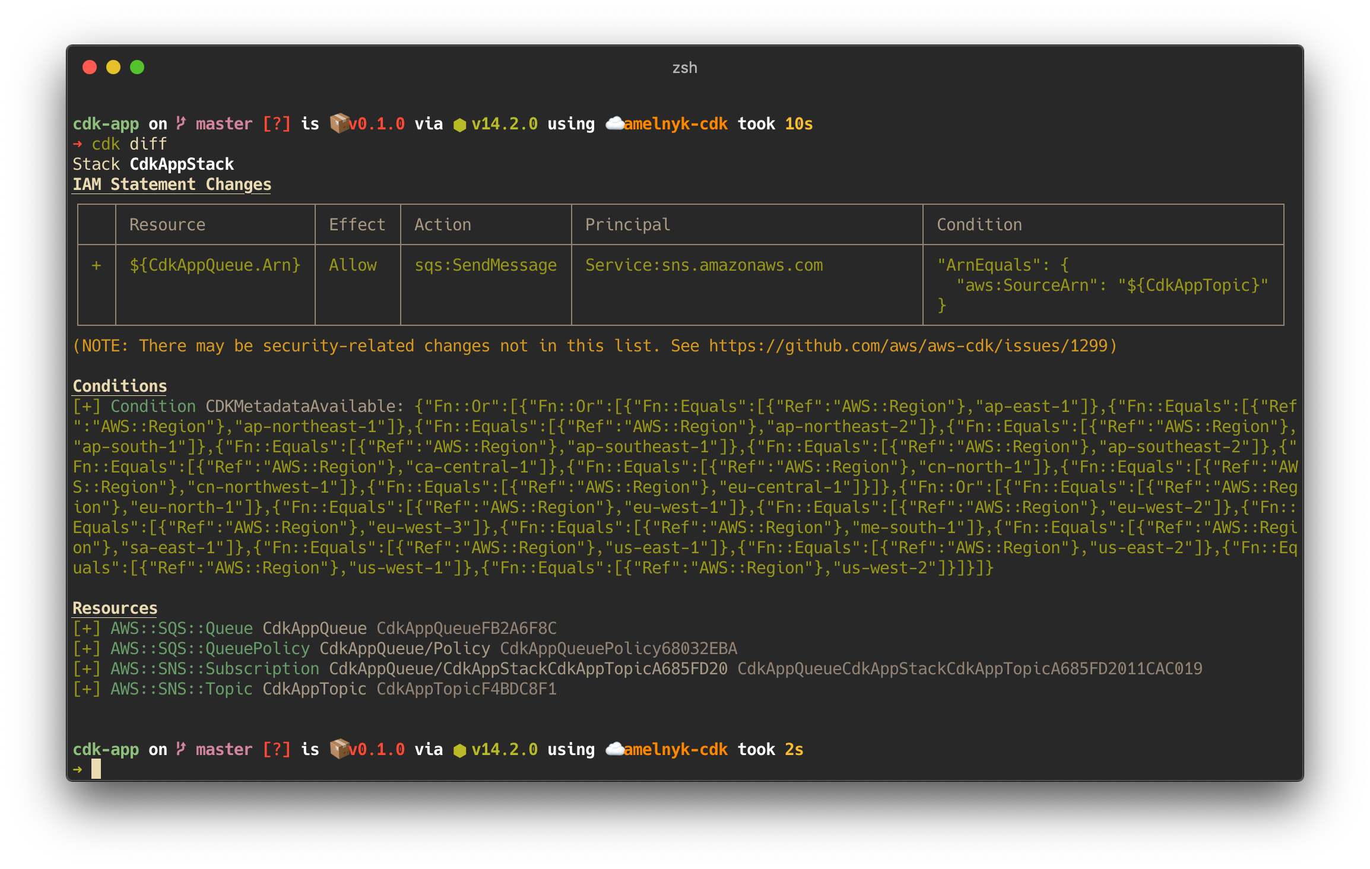


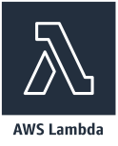
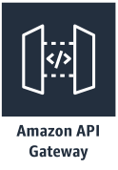
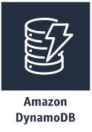
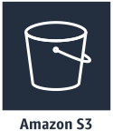


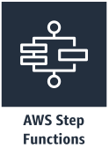

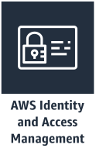



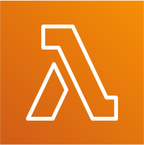


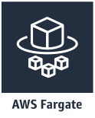

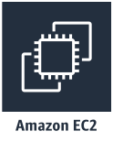
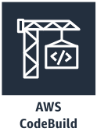
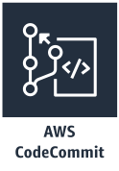
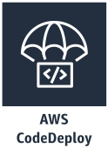
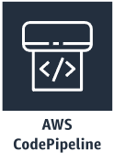
Main Components
Serverless
App Integration / Foundational Services
App
Stacks
Containers
CI/CD
Resources
Core Framework
AWS Construct Library
AWS CDK CLI

Slide 14

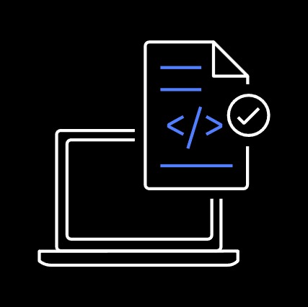
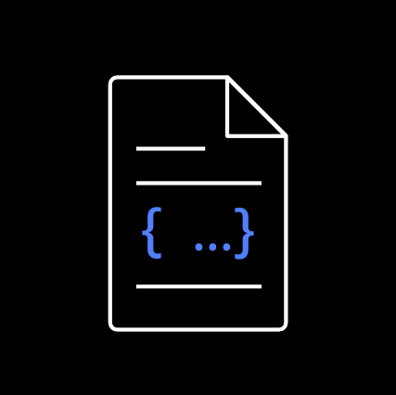


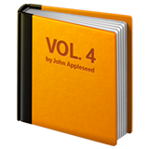




Development Workflow
execute
synthesize
deploy
provision
Stacks & Constructs
Source Code
CDK CLI
Templates + Assets
Cloud Assembly
AWS CloudFormation
Cloud Resources
cdk init
// create new project
npm run build
// build project
cdk synth
// create templates and assets
cdk diff
// check what will change
cdk deploy
// push changes to your account
https://www.youtube.com/watch?v=R7wSTZ54gNk&t=261s
© 2020, Amazon Web Services, Inc. or its Affiliates. All rights reserved. Amazon Confidential and Trademark.

Slide 15
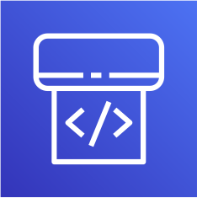
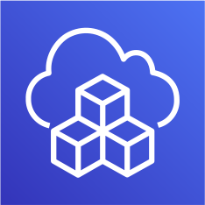



Best Practice – Deploy to multiple accounts
Fubuki’s Account
Saitama’s Account
Shared Services Account
Pipeline
cdk deploy
Source
Control
git push
Dev
Account
Homol
Account
Prod
Account
Fubuki
Saitama

Slide 16
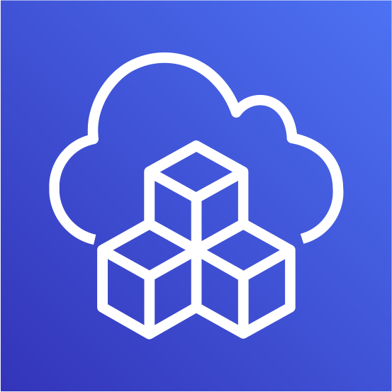
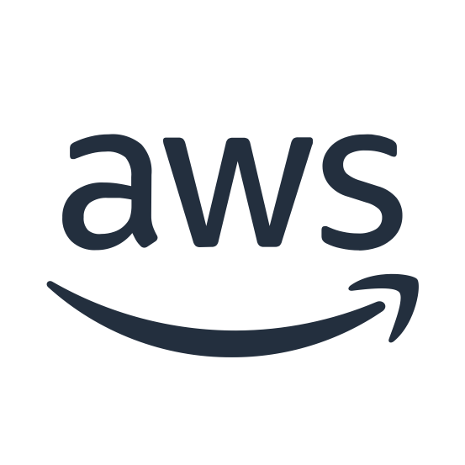
Application Development

Slide 17
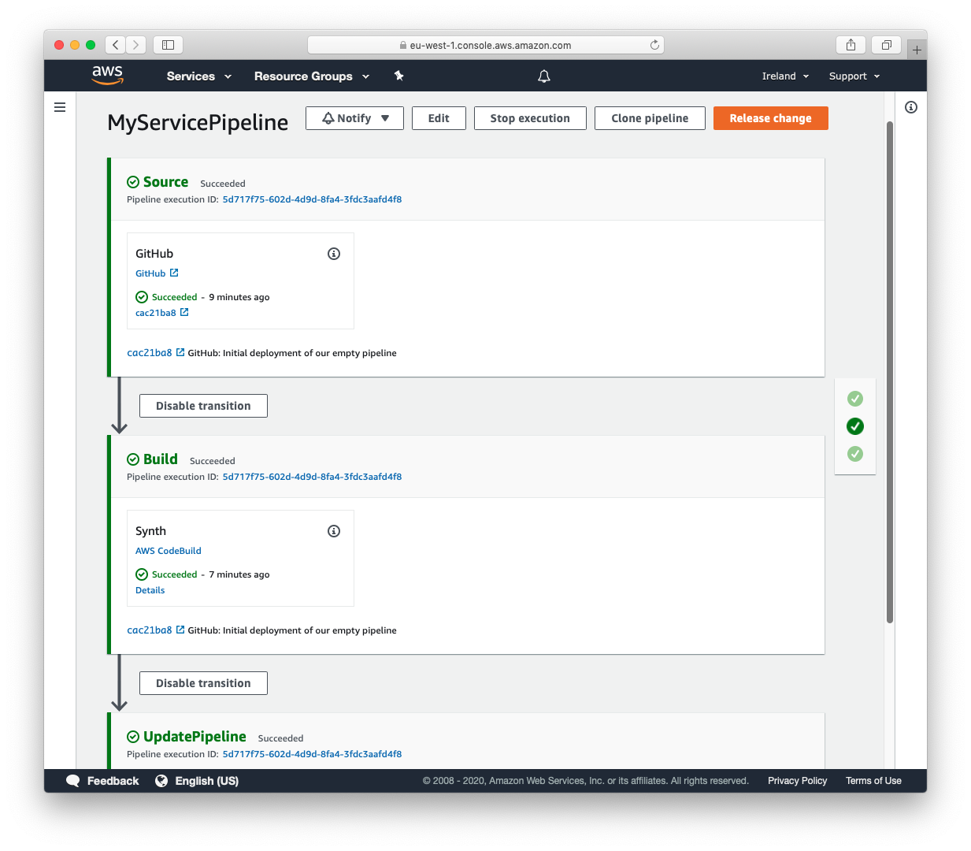
CDK Pipelines
Continuous delivery for AWS CDK applications
Model continuous delivery pipelines as
part of your infrastructure code.
Easily model cross-account and cross-region
pipeline configurations.
Pipelines are self modifying as
you push your CDK code to origin.

Slide 18
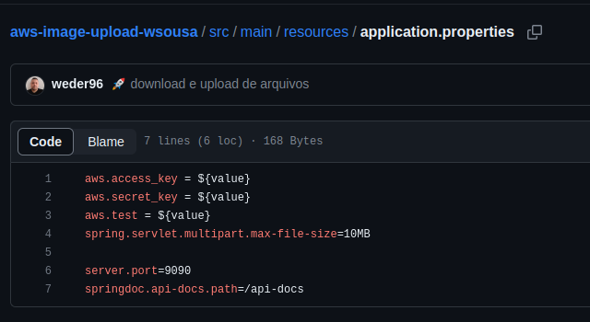
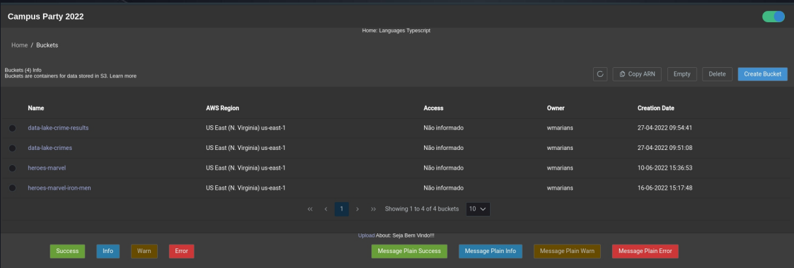
Demo CDK
Clone S3 AWS with CDK
https://github.com/weder96/aws-image-upload-wsousa
https://github.com/weder96/presentationCampusParty2022

Slide 19
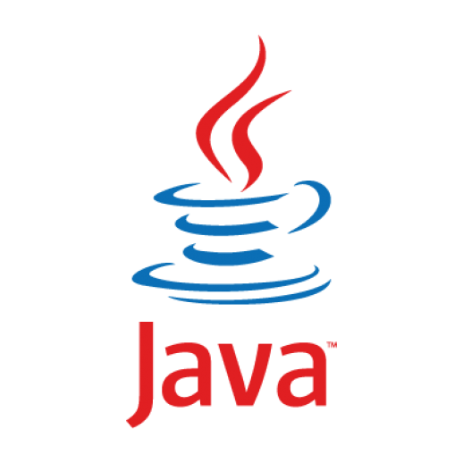

4. Amazon Corretto

Slide 20
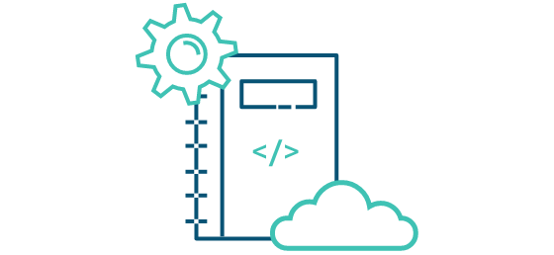
What is Amazon Corretto ?
Amazon Corretto is a no-cost, multiplatform, production-ready distribution of the Open Java Development Kit (OpenJDK).
Corretto comes with Long-Term Support(LTS) that will include performance enhancements and security fixes. Amazon runs Corretto internally on thousands of production services and Corretto is certified as compatible with the Java SE standard. With Corretto, you can develop and run Java applications on popular operating systems, including Linux, Windows, and macOS.
https://aws.amazon.com/corretto/?filtered-posts.sort-by=item.additionalFields.createdDate&filtered-posts.sort-order=desc

Slide 21
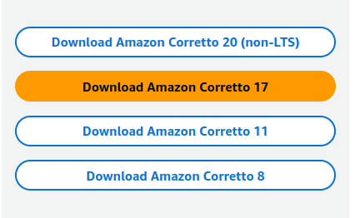
Long-Term Support(LTS) ?
Benefits
1. Backed by Amazon
2. Production Ready
3. Multiplatform Support
4. No Cost
https://aws.amazon.com/corretto/?filtered-posts.sort-by=item.additionalFields.createdDate&filtered-posts.sort-order=desc

Slide 22
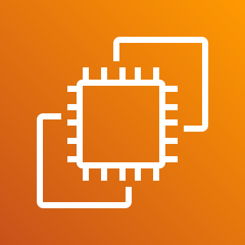

5. EC2 with Spring boot

Slide 23


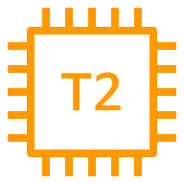



Architecture (EC2)
BackEnd
AWS Cloud
Availability Zone
EC2 instance
SSH
Permissions
T2 instance

Slide 24




Ec2 Baisc Server Instance
https://github.com/weder96/campusParty3/tree/main/backEnd/campus

Slide 25




Ec2 Baisc Server Instance - Deploy Application Java and Mysql
https://github.com/weder96/campusParty3/tree/main/backEnd/campus

Slide 26

6. Beanstalk and Spring boot

Slide 27
Architecture (Beanstalk)
BackEnd
AWS Cloud
Availability Zone
EC2 instance
choose Jar
AWS Elastic Beanstalk
T2 instance

Slide 28


7. Docker and Fargate with Spring boot

Slide 29

Architecture (Docker Hub)
BackEnd
Hub
AWS Cloud
Availability Zone
EC2 instance
push
pull
install
T2 instance

Slide 30


Create Account Docker Hub(Repository) and Login

Slide 31



Push Project Spring boot to Docker Hub
https://github.com/weder96/campusParty3/tree/main/backEnd/campus_docker

Slide 32


Pull Project Docker Hub
https://docs.docker.com/engine/reference/commandline/pull/

Slide 33


Test Project Spring boot (localhost)

Slide 34




Test Project Spring boot (EC2 Instance)
https://www.digitalocean.com/community/tutorials/how-to-install-and-use-docker-on-ubuntu-20-04-pt

Slide 35


Architecture (Docker Hub and Fargate)
BackEnd
Hub
AWS Cloud
Availability Zone
AWS Fargate
push
pull
Amazon Elastic Container Service (Amazon ECS)
Amazon CloudWatch

Slide 36


ECS and Fargate
# Create Cluster
# Create Task Definitions

Slide 37



Create Task Definitions

Slide 38

Linked Task and Cluster

Slide 39

Log Events - Cloud Watch

Slide 40

Call API by Public IP:Port

Slide 41

8. Pipelines com Java Spring boot

Slide 42



Architecture (Codepipeline)
BackEnd
AWS Cloud
AWS CodePipeline
T2 instance
push
pull
AWS CodeBuild
AWS CodeDeploy

Slide 43

9. Serverless - Java and Lambda

Slide 44

Architecture (Serverless)
BackEnd
AWS Cloud
17
Command CLI or Upload
Lambda function

Slide 45



Springboot Lambda Demo
https://github.com/weder96/springboot-aws-lambda
https://docs.spring.io/spring-cloud-function/docs/current/reference/html/aws.html

Slide 46


Springboot Lambda Demo
# Create Lambda Function Java 17
https://github.com/weder96/springboot-aws-lambda

Slide 47


Springboot Lambda Demo
#Upload Jar generate command line mvn clean Install
#Runtime Settings
https://github.com/weder96/springboot-aws-lambda

Slide 48


Springboot Lambda Demo
#Environment variables
#Test
https://github.com/weder96/springboot-aws-lambda

Slide 49

Springboot Lambda Demo
#Result Test Invoke
https://github.com/weder96/springboot-aws-lambda

Slide 50
10. AWS Lambda SnapStart for Spring Developers

Slide 51

Architecture (Serverless)
BackEnd
AWS Cloud
17
Version 2
Command CLI
Lambda function
Snap Start
Lambda function

Slide 52
Reducing Cold Start
SNAPSTART
Init during deployment
Create
Execution
Environment
Download
Code
Start
Runtime
Initialize
Function
Code
Pre
Snapshot
Hook
Create
Snapshot
(optional)
Resume
Invoke
Invoke
first request
Resume
Snapshot
Post
Snapshot
Hook
Code
execution
Code
execution
(optional)
https://aws.amazon.com/pt/blogs/compute/starting-up-faster-with-aws-lambda-snapstart/

Slide 53


AWS Lambda SnapStart + Spring Cloud Function
https://github.com/weder96/snapstart

Slide 54



AWS Lambda SnapStart + Spring Cloud Function
https://github.com/weder96/snapstart

Slide 55


AWS Lambda SnapStart + Spring Cloud Function
https://github.com/weder96/snapstart

Slide 56


Want to Try?
Workshop Java on AWS Lambda
https://s12d.com/java-workshop

Slide 57
Resources
https://cdkworkshop.com
https://github.com/aws-samples/aws-cdk-examples
https://docs.aws.amazon.com/cli/latest/userguide/getting-started-install.html
https://aws.amazon.com/pt/developer/language/java/
https://docs.aws.amazon.com/toolkit-for-jetbrains/latest/userguide/setup-toolkit.html
https://aws.amazon.com/pt/intellij/
https://docs.aws.amazon.com/code-library/latest/ug/java_2_code_examples.html
https://docs.aws.amazon.com/pt_br/prescriptive-guidance/latest/patterns/deploy-a-ci-cd-pipeline-for-java-microservices-on-amazon-ecs.html
https://docs.aws.amazon.com/lambda/latest/dg/lambda-java.html
https://aws.amazon.com/pt/blogs/compute/java-17-runtime-now-available-on-aws-lambda/
https://www.slideshare.net/AmazonWebServices/java-on-aws
https://www.jrebel.com/blog/aws-java-application-setup
https://www.slideshare.net/VadymKazulkin/adopting-java-for-the-serverless-world-at-jax-2022
https://towardsaws.com/deploy-spring-boot-application-to-aws-ec2-using-docker-f359e7ad2026
https://aws.amazon.com/pt/blogs/developer/stepfunctions-fluent-api/
https://aws.amazon.com/blogs/compute/java-17-runtime-now-available-on-aws-lambda/
https://docs.aws.amazon.com/lambda/latest/dg/snapstart.html

Slide 58
About the speaker
Q & A
Weder Mariano de Sousa
Specialist Senior - GFT
Graduated Computer Science
https://www.linkedin.com/in/wedermarianodesousa/
Post Graduate in Midias UFG
https://github.com/weder96
Post Graduate in Information Security
https://twitter.com/weder96
https://dev.to/weder96
GOJava
AWS User Group Goiânia

Slide 59
THANK YOU

